Slide 1
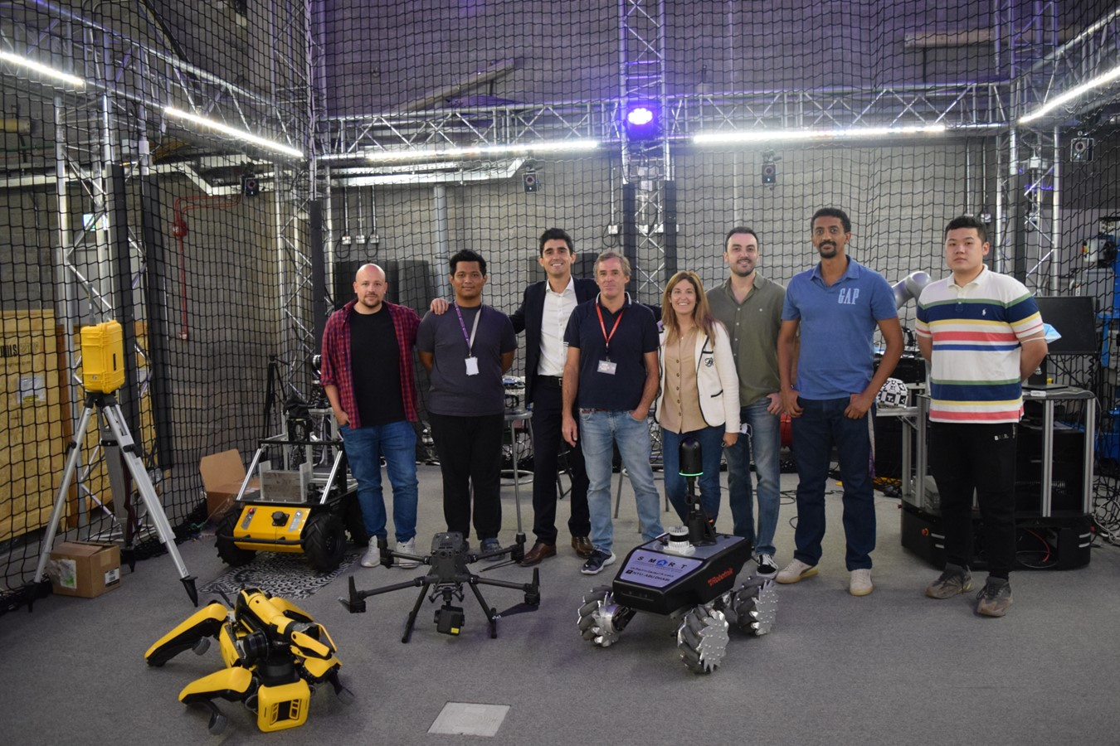




Robotics Research
at S.M.A.R.T.
Part 2 of 2
Borja García de Soto, PhD, PE

Slide 2


Sustainable and resilient construction
Overview
Modularization and lean construction
Our goal is to bridge scholarly excellence with practical application, optimizing every stage of the infrastructure lifecycle to build resilient future communities.
Artificial intelligence
Robotic systems and automation
Technology integration & information modelling

Slide 3


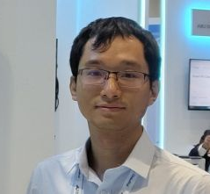




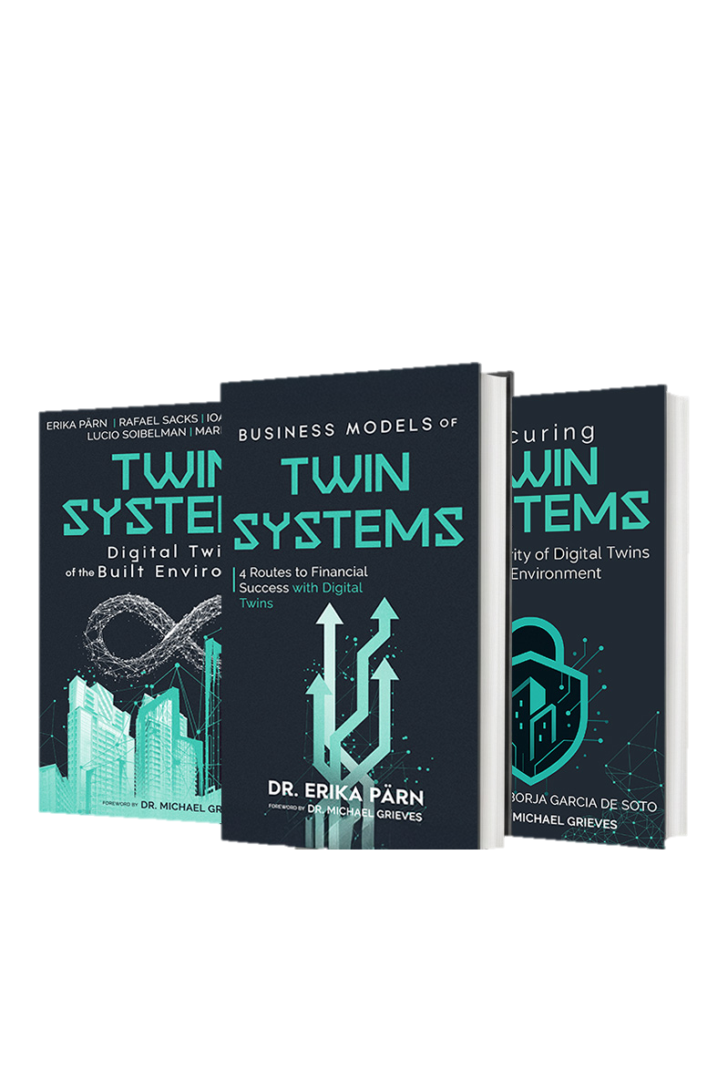



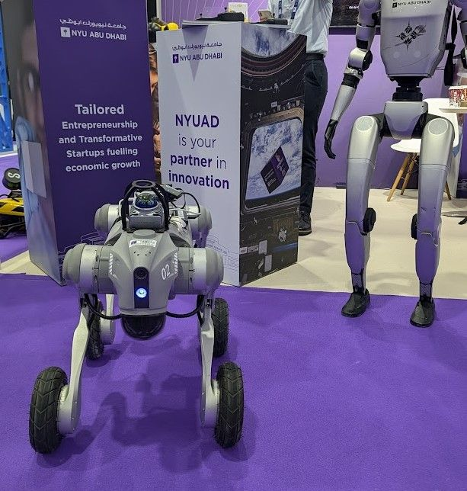
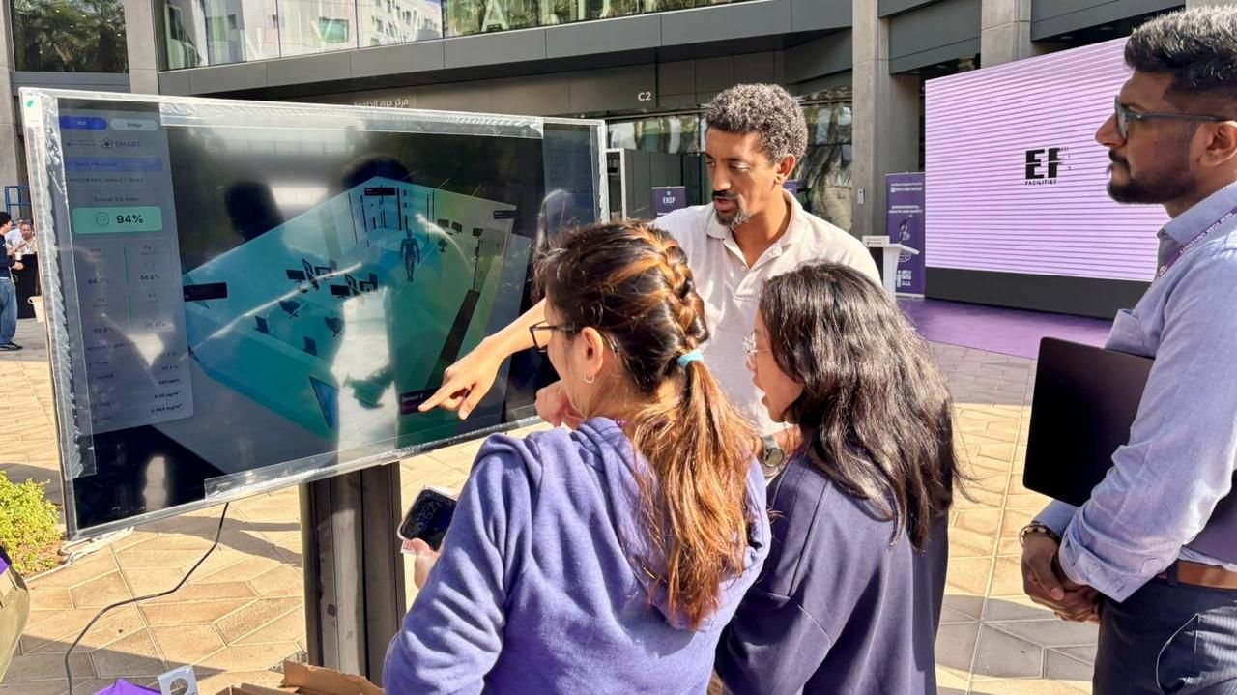

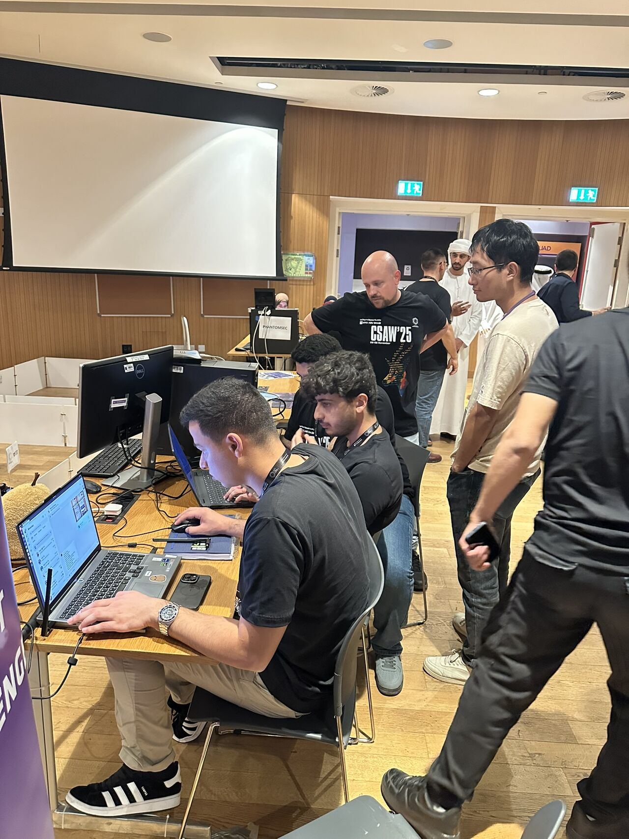
Research Team | people Of S.M.A.R.T. Labs
Borja García De Soto
Eyob Mengiste
Erika A. Pärn
Zihao Zheng
Associate Professor
Instructor and Researcher
Research Scientist
Postdoctoral Associate
Semih Sonkor
Dongchi (Daniel) Yao
Nas Gopee
Boyu Wang
PhD Student
Postdoctoral Associate
Research Assistant
Postdoctoral Associate

Slide 4
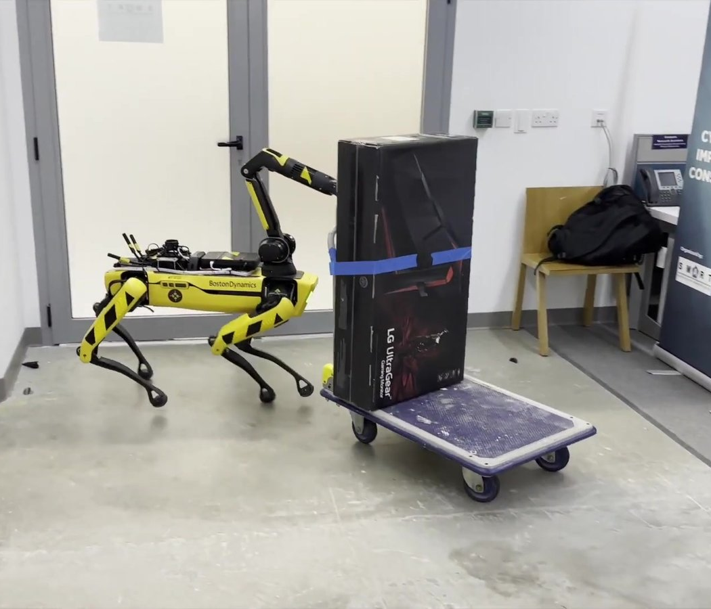
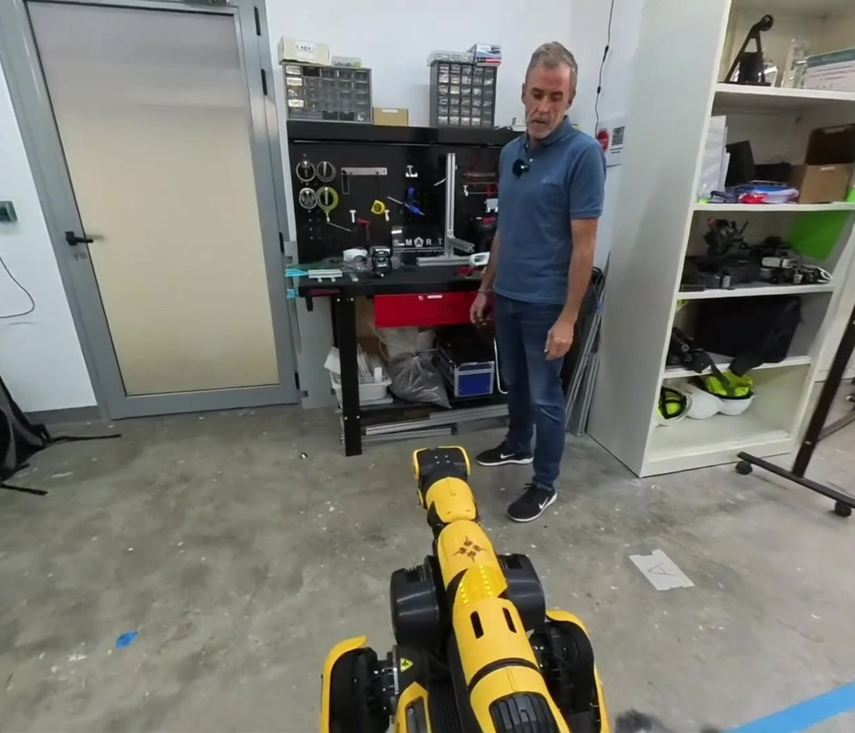
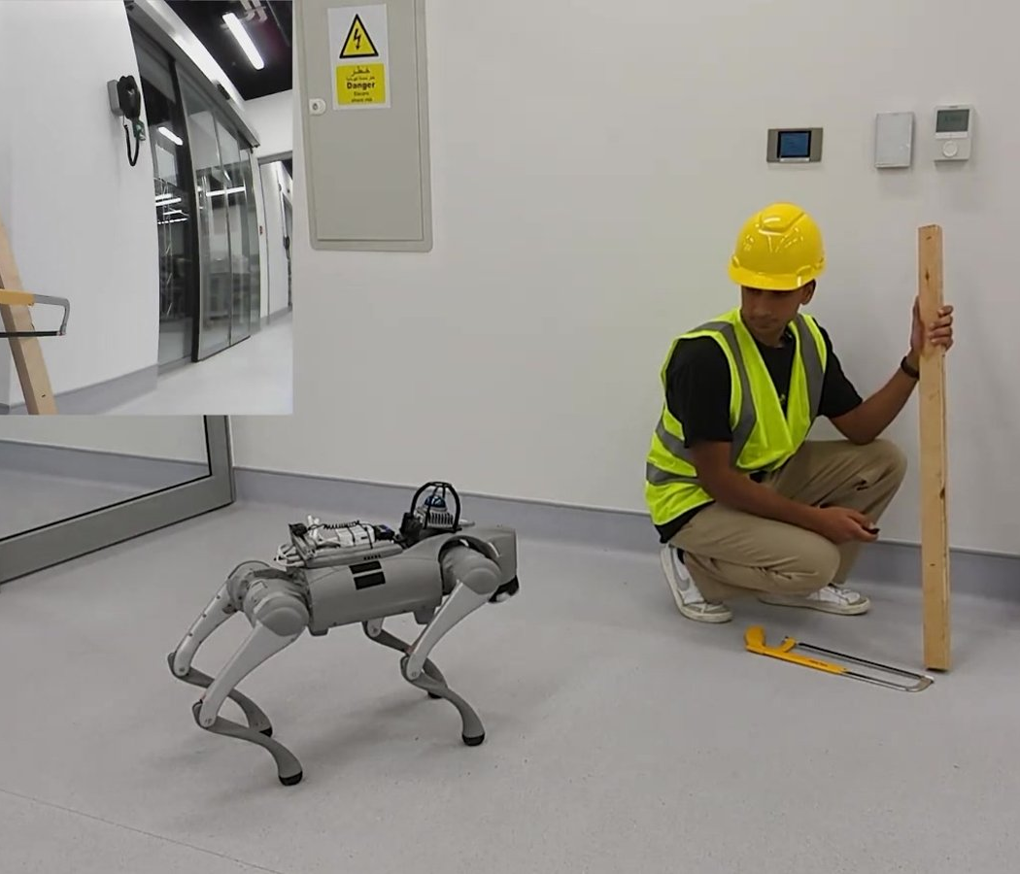
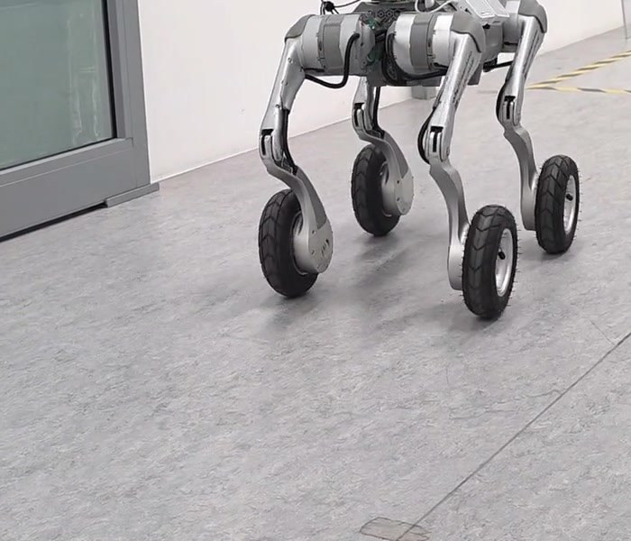
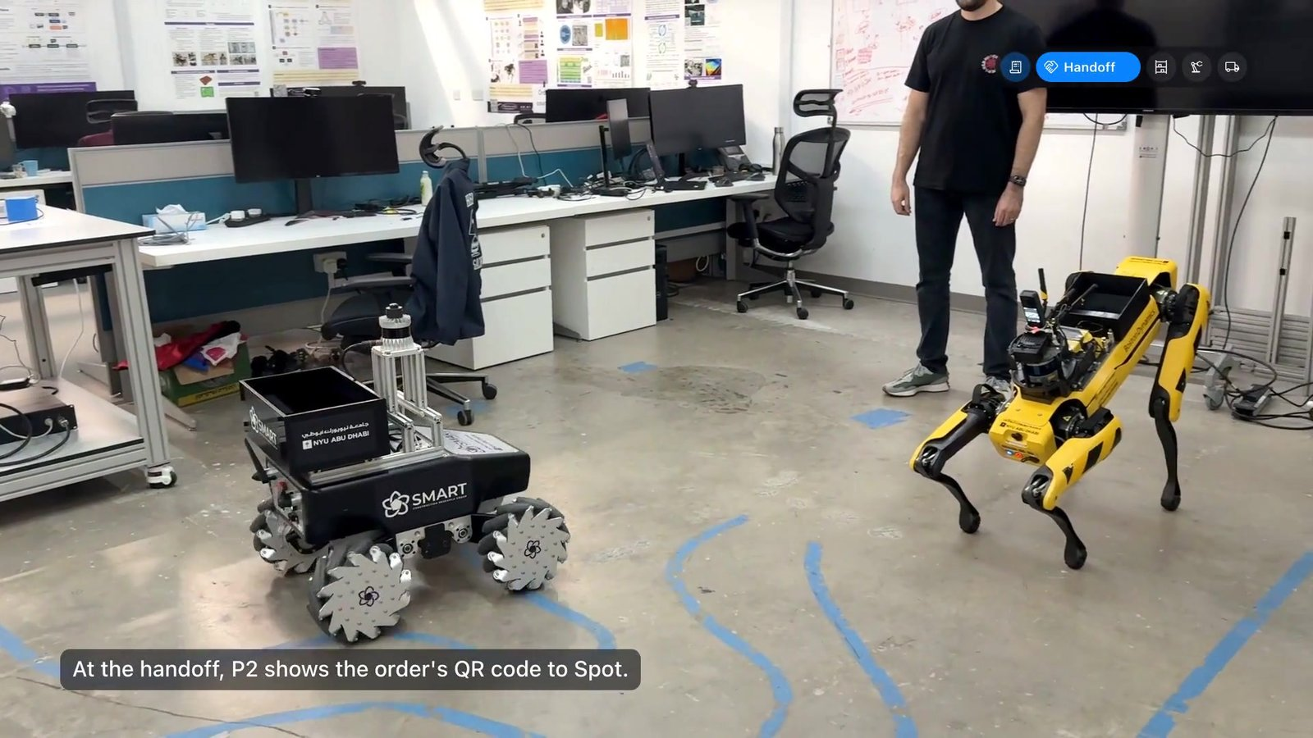
Our Robotics Research | Overview
02
Multi-Agent Robotic System
03
PACA
04
LISA
05
SiteScope
06
Logistics Challenge
Robots and a human split the work to digitize a cluttered site.
Workers talk to a robot assistant; a cloud multimodal LLM plans its actions.
The same idea running locally: private, offline, speech-driven safety checks.
Schedule-driven robot inspections, from capture to published report.
Three robots and five people fill delivery orders together.
SUMMIT-XL · Spot with Arm
Spot with Arm
Go2 · Go2-W
Go2-W
SUMMIT-XL · Spot · FR3 arm
J. Field Robotics 2024
ICRA 2025 Workshop
CCC 2025 · AutCon 2026
IROS 2026 Workshop
Lab demonstration

Slide 5

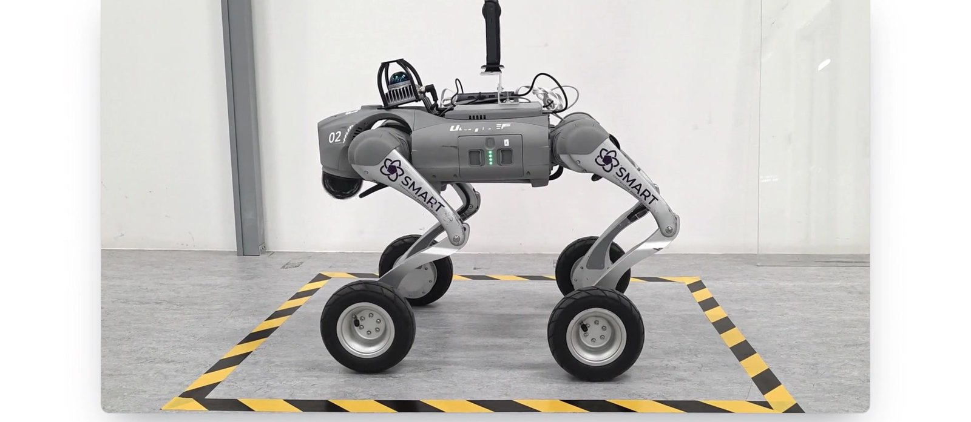

05
SiteScope: Schedule-Driven
Robotic Progress Monitoring

Slide 6
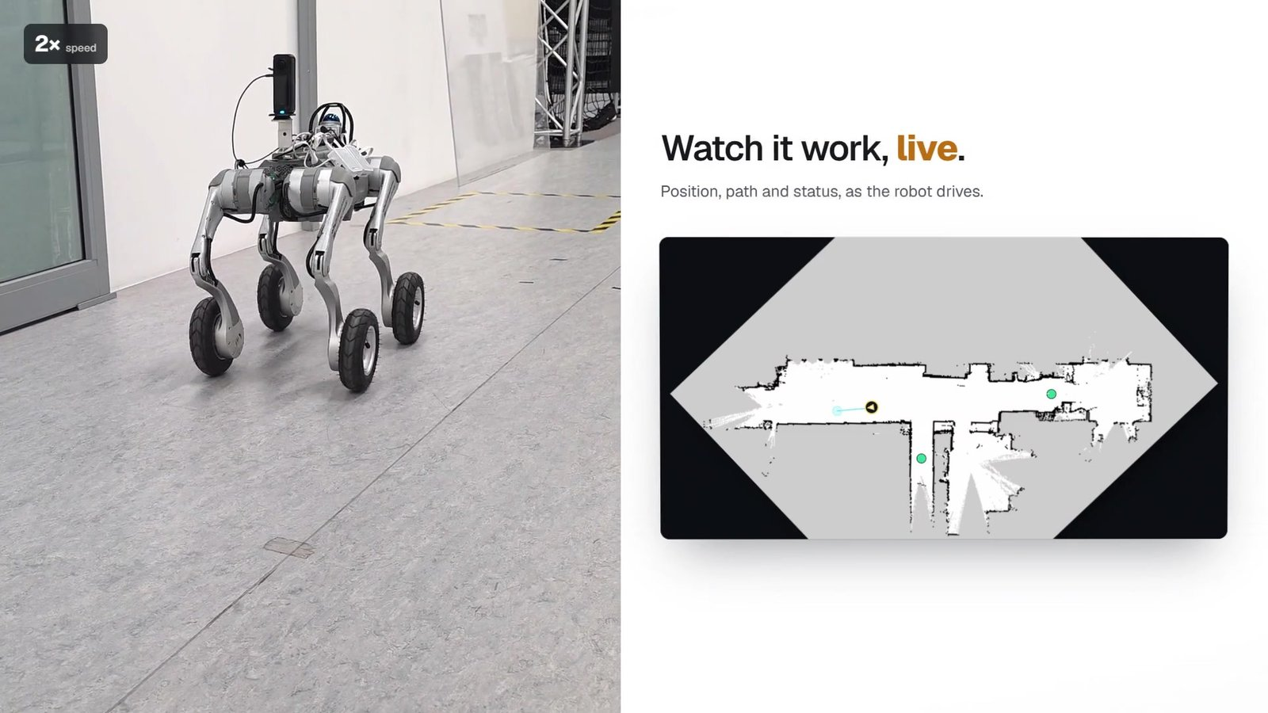
SiteScope | Introduction
05 SITESCOPE
The challenge
1
Progress documentation is manual: prepare a camera, walk the site, capture, transfer, upload, write it up.
2
Repeated inspections are hard to keep consistent and use skilled people's time.
3
Existing tools automate one step, not the chain from schedule to report.
Our idea
A recurring schedule sends the Go2-W to each capture point. It captures 360° images, uploads them with full provenance, and SiteScope stores, analyses and helps people publish the report.
−28.2%
57 s
end-to-end time per inspection
human time, vs 10 min 20 s
[5] Mengiste, Prieto & García de Soto (2026). SiteScope: An end-to-end schedule-driven robotic workflow for construction progress monitoring. IROS 2026 Workshop (camera-ready).

Slide 7
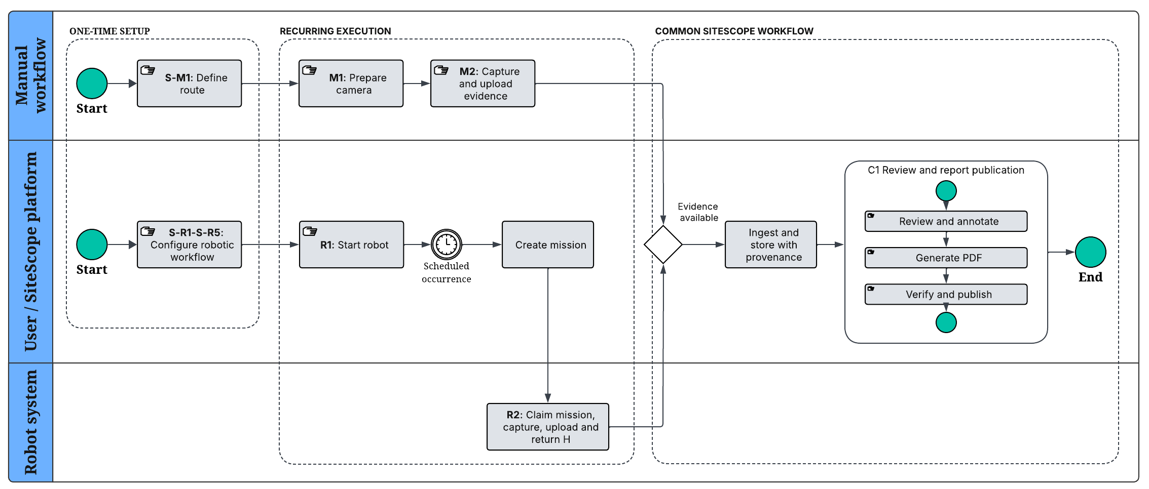
SiteScope | Methodology
05 SITESCOPE
Schedule-to-report workflow: one-time setup, recurring manual vs. robotic execution, and the shared review-and-report subprocess C1 [5]

Slide 8
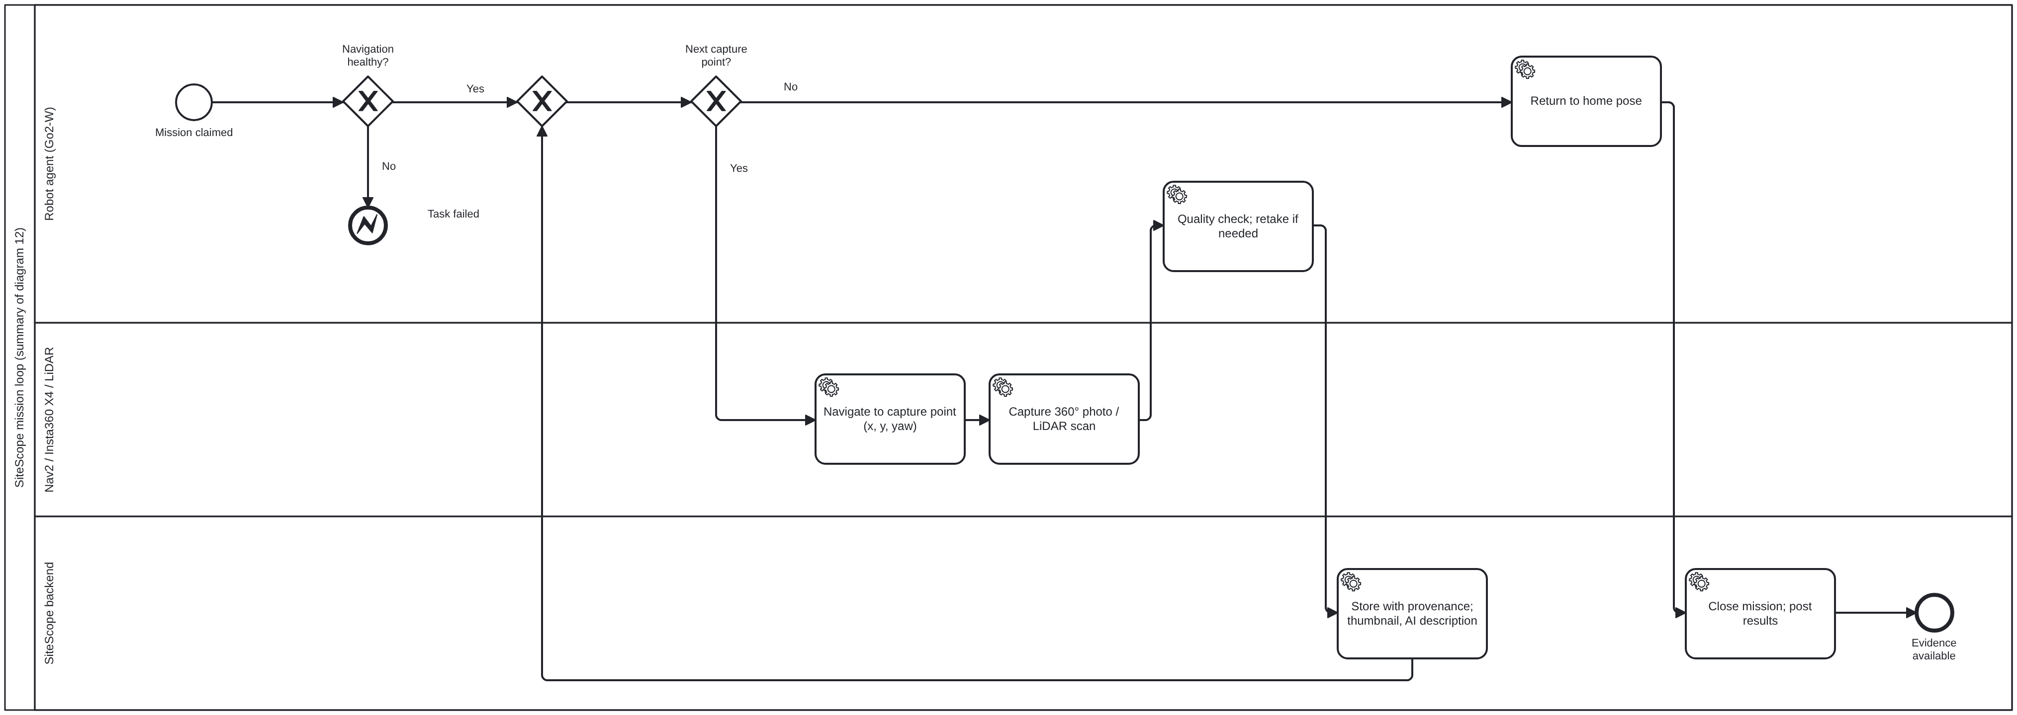
SiteScope | Robot Mission Loop
05 SITESCOPE
What R2 does on every scheduled run, drawn from the SiteScope code. Full detail (cancel, stop, watchdog, failure paths): Media/BPMN/SiteScope, diagrams 11 and 12

Slide 9
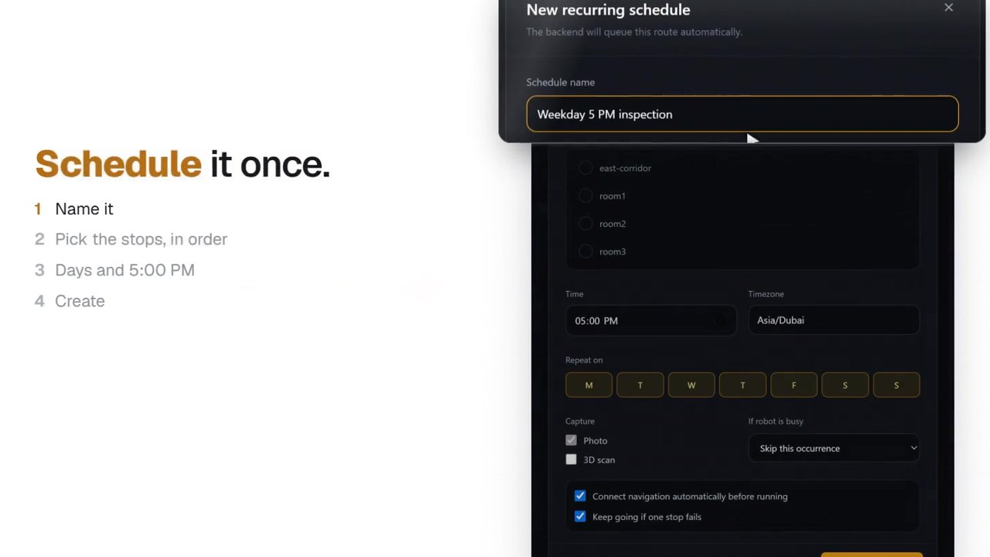
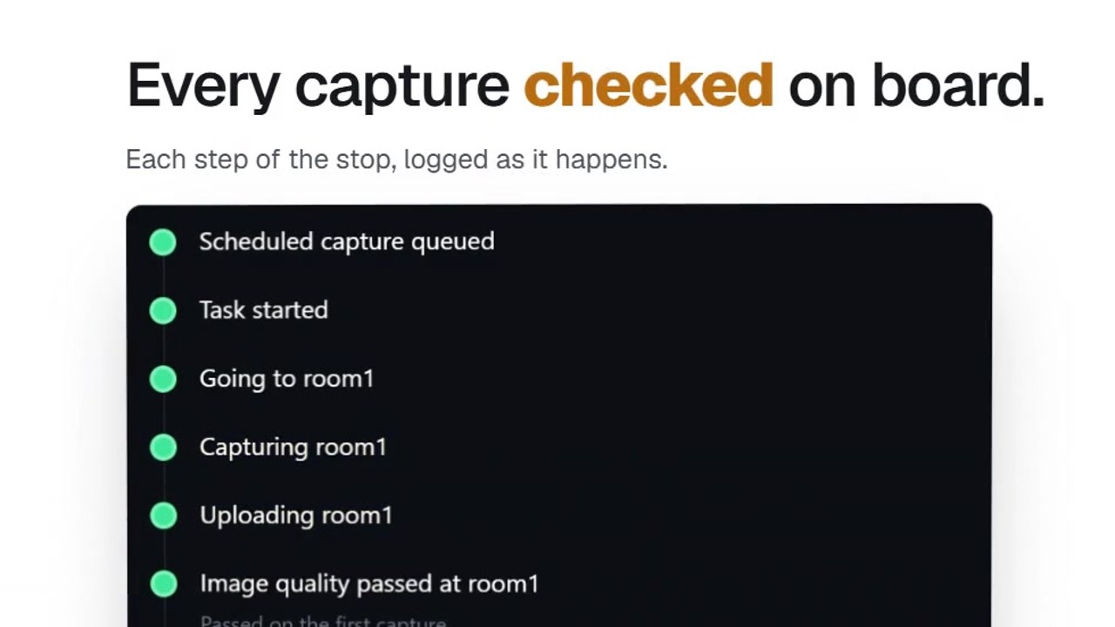
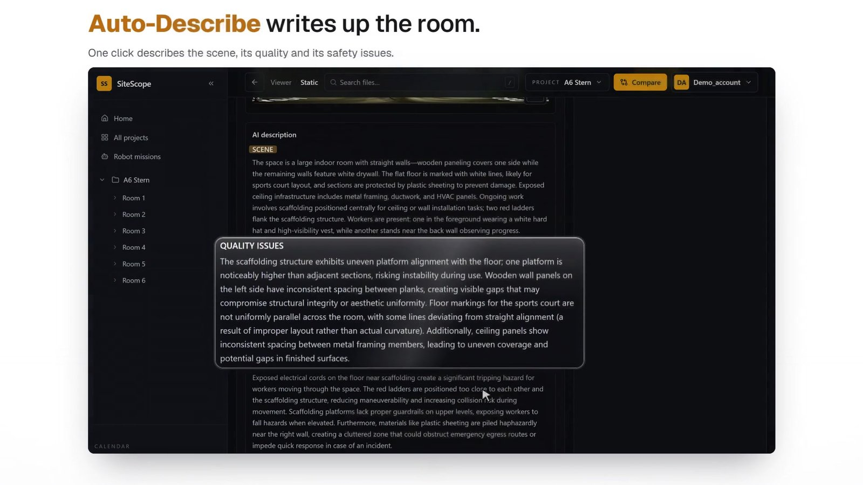
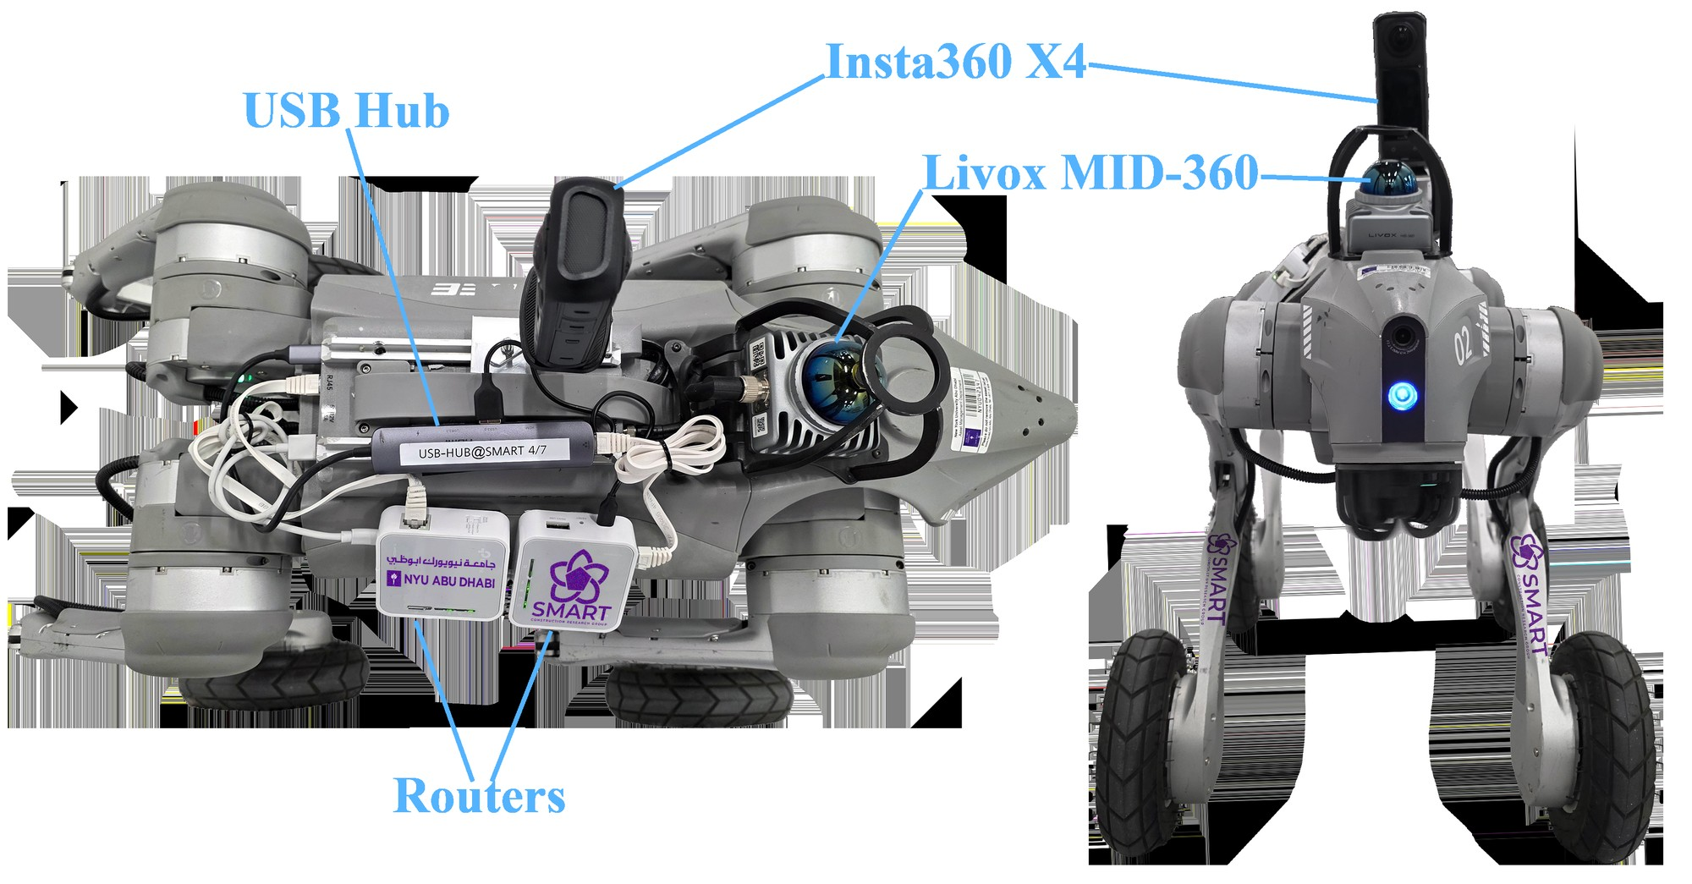
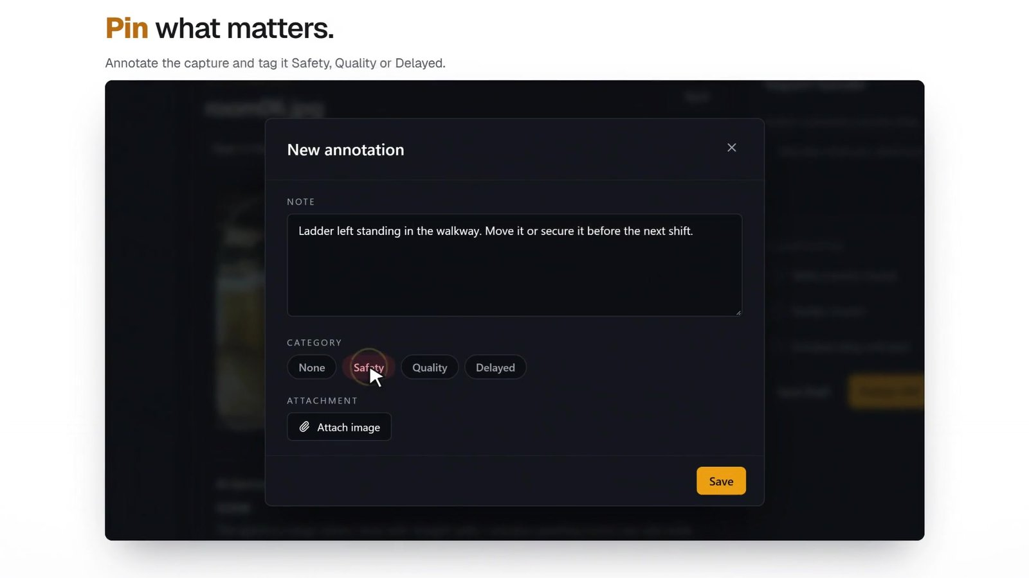
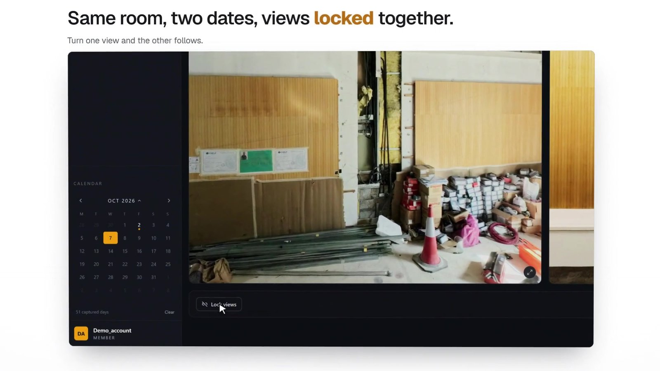
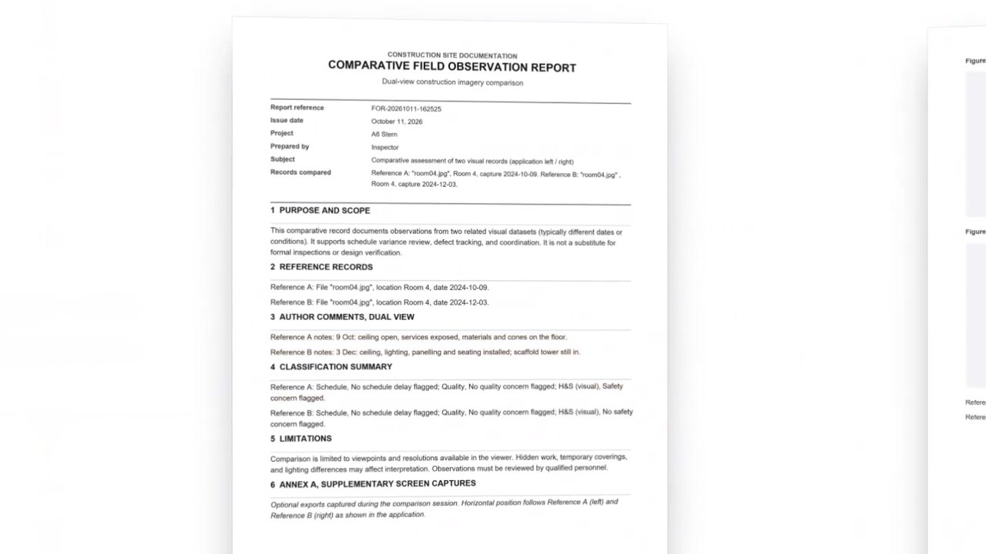
SiteScope | Robot and Platform
05 SITESCOPE
Schedule it once
Every capture checked on board
Auto-Describe: scene, quality, safety
Go2-W sensing payload
Insta360 X4: 72 MP 360° photos
Livox MID-360 LiDAR for navigation
Jetson Orin NX + ROS 2 / Nav2
Two routers: ROS and data links
Pin what matters
Same room, two dates
One PDF report
Provenance: every asset is stored with its project, location, date, mission, waypoint, sensor and robot pose.

Slide 10
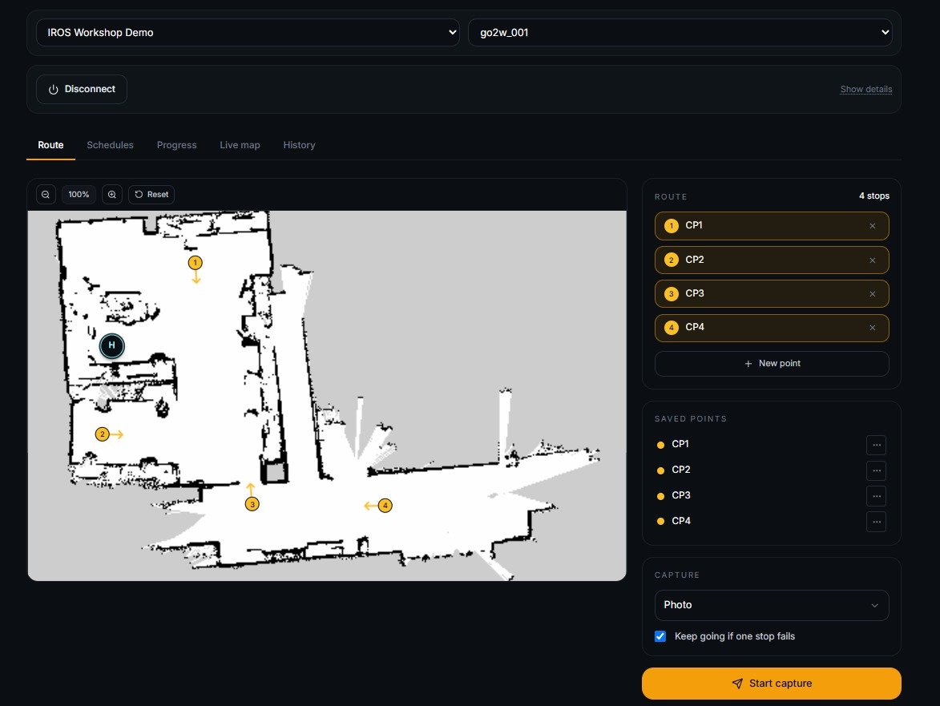
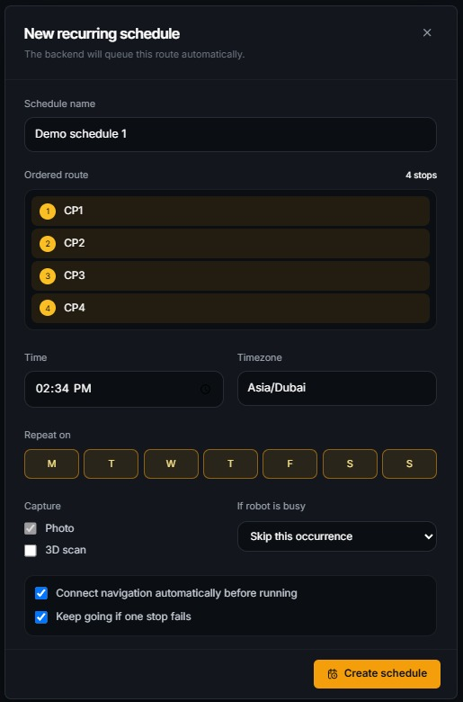
SiteScope | Experiment
05 SITESCOPE
1
Same inspection package
4 capture points → 4 × 360° images + 1 PDF report per run.
2
5 paired trials
10 runs, alternating Manual → Robot and Robot → Manual.
3
Same everything else
Route, camera settings (72 MP, HDR off), user, internet, report template.
4
One difference
Navigation map with home pose H and capture points CP1–CP4 [5]
Recurring schedule
Manual camera on a 1.25 m pole; robot camera fixed at 0.67 m.
[5] Mengiste, Prieto & García de Soto (2026). SiteScope: An end-to-end schedule-driven robotic workflow for construction progress monitoring. IROS 2026 Workshop (camera-ready).

Slide 11
SiteScope | Results
05 SITESCOPE
−28.2%
end-to-end: 10:20 → 7:25 per inspection
−99.1%
human time until images are in SiteScope: 9:28 → 0:05
5 / 5
robot missions completed; 20 / 20 images, 0 retries
Trade-off: one-time robot setup takes 15:31 (payload, map and home pose, pairing, capture points, schedule) vs 4:47 to plan the manual route. With 9:23 of human time saved per inspection, the extra 10:44 is repaid during the second inspection (our estimate from Tables I–II).
[5] Mengiste, Prieto & García de Soto (2026). SiteScope: An end-to-end schedule-driven robotic workflow for construction progress monitoring. IROS 2026 Workshop (camera-ready).

Slide 12
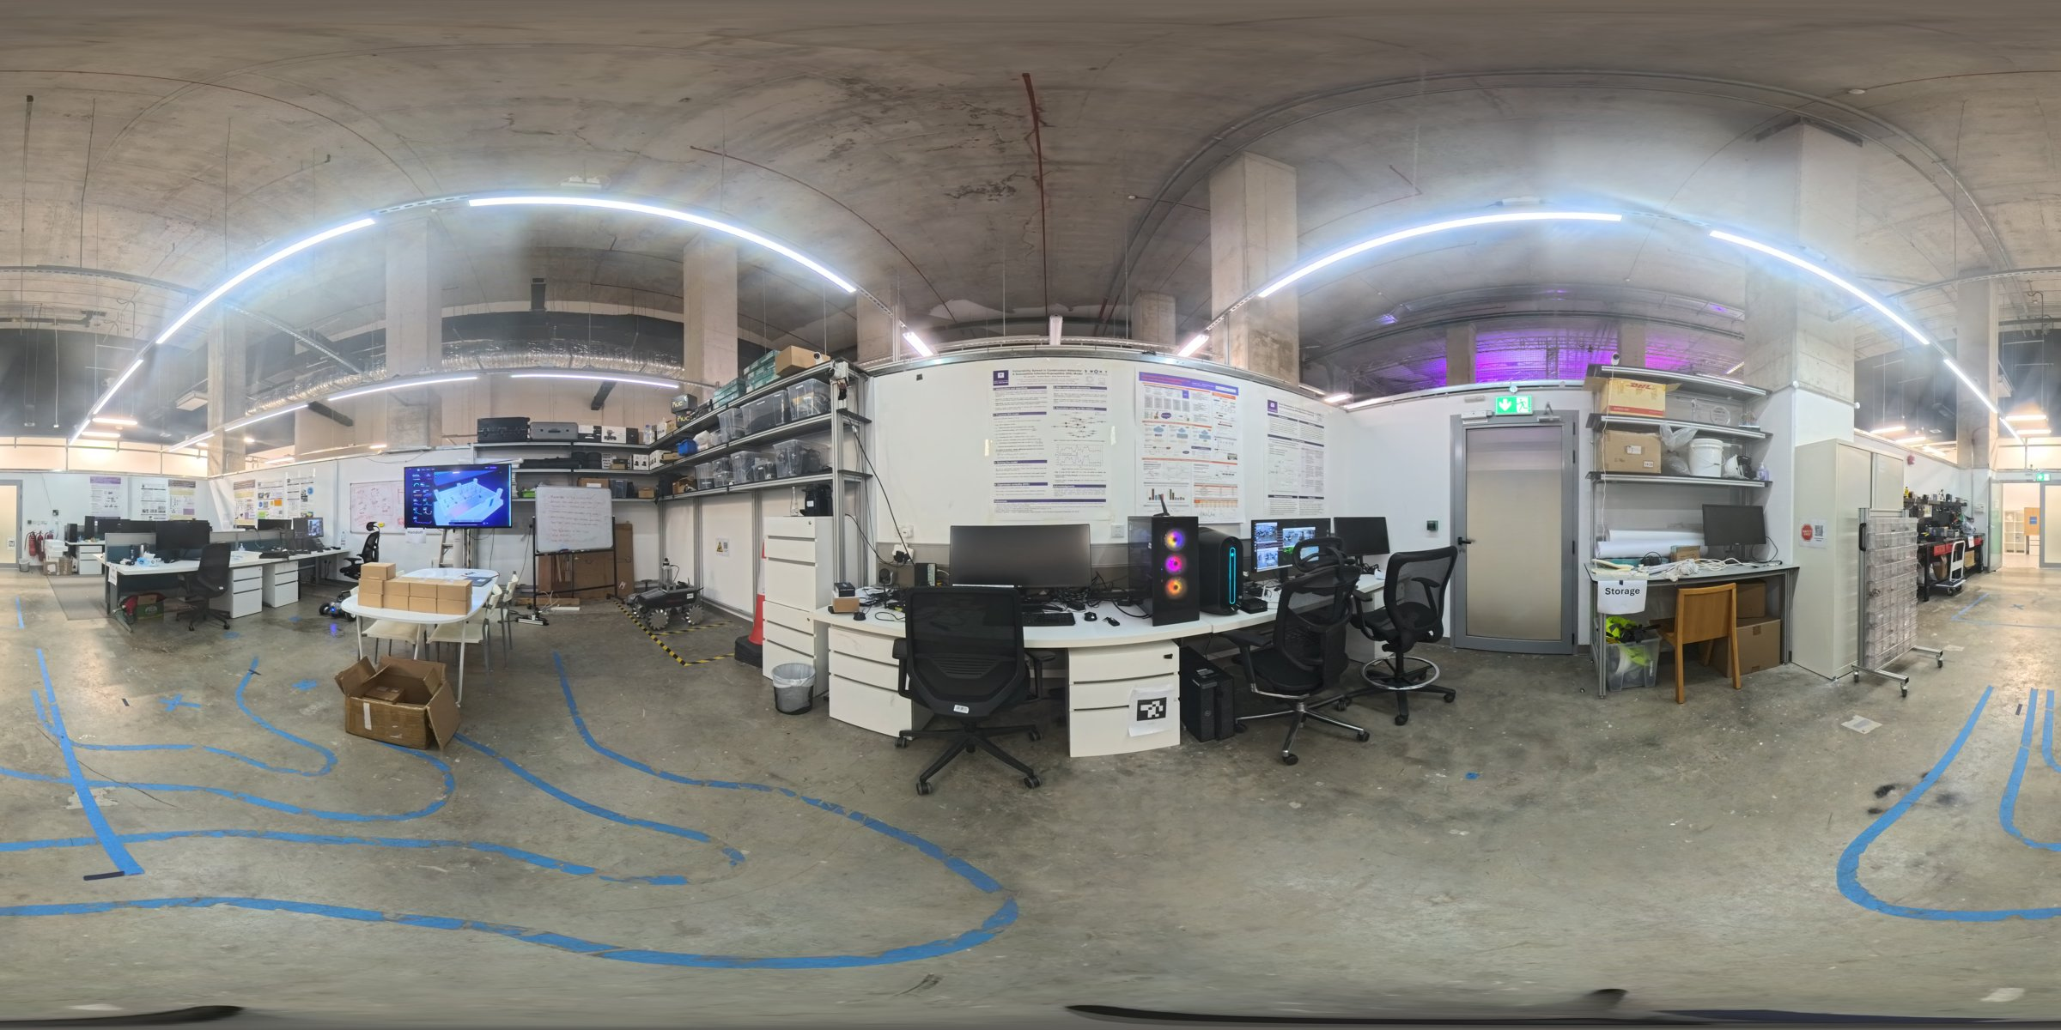
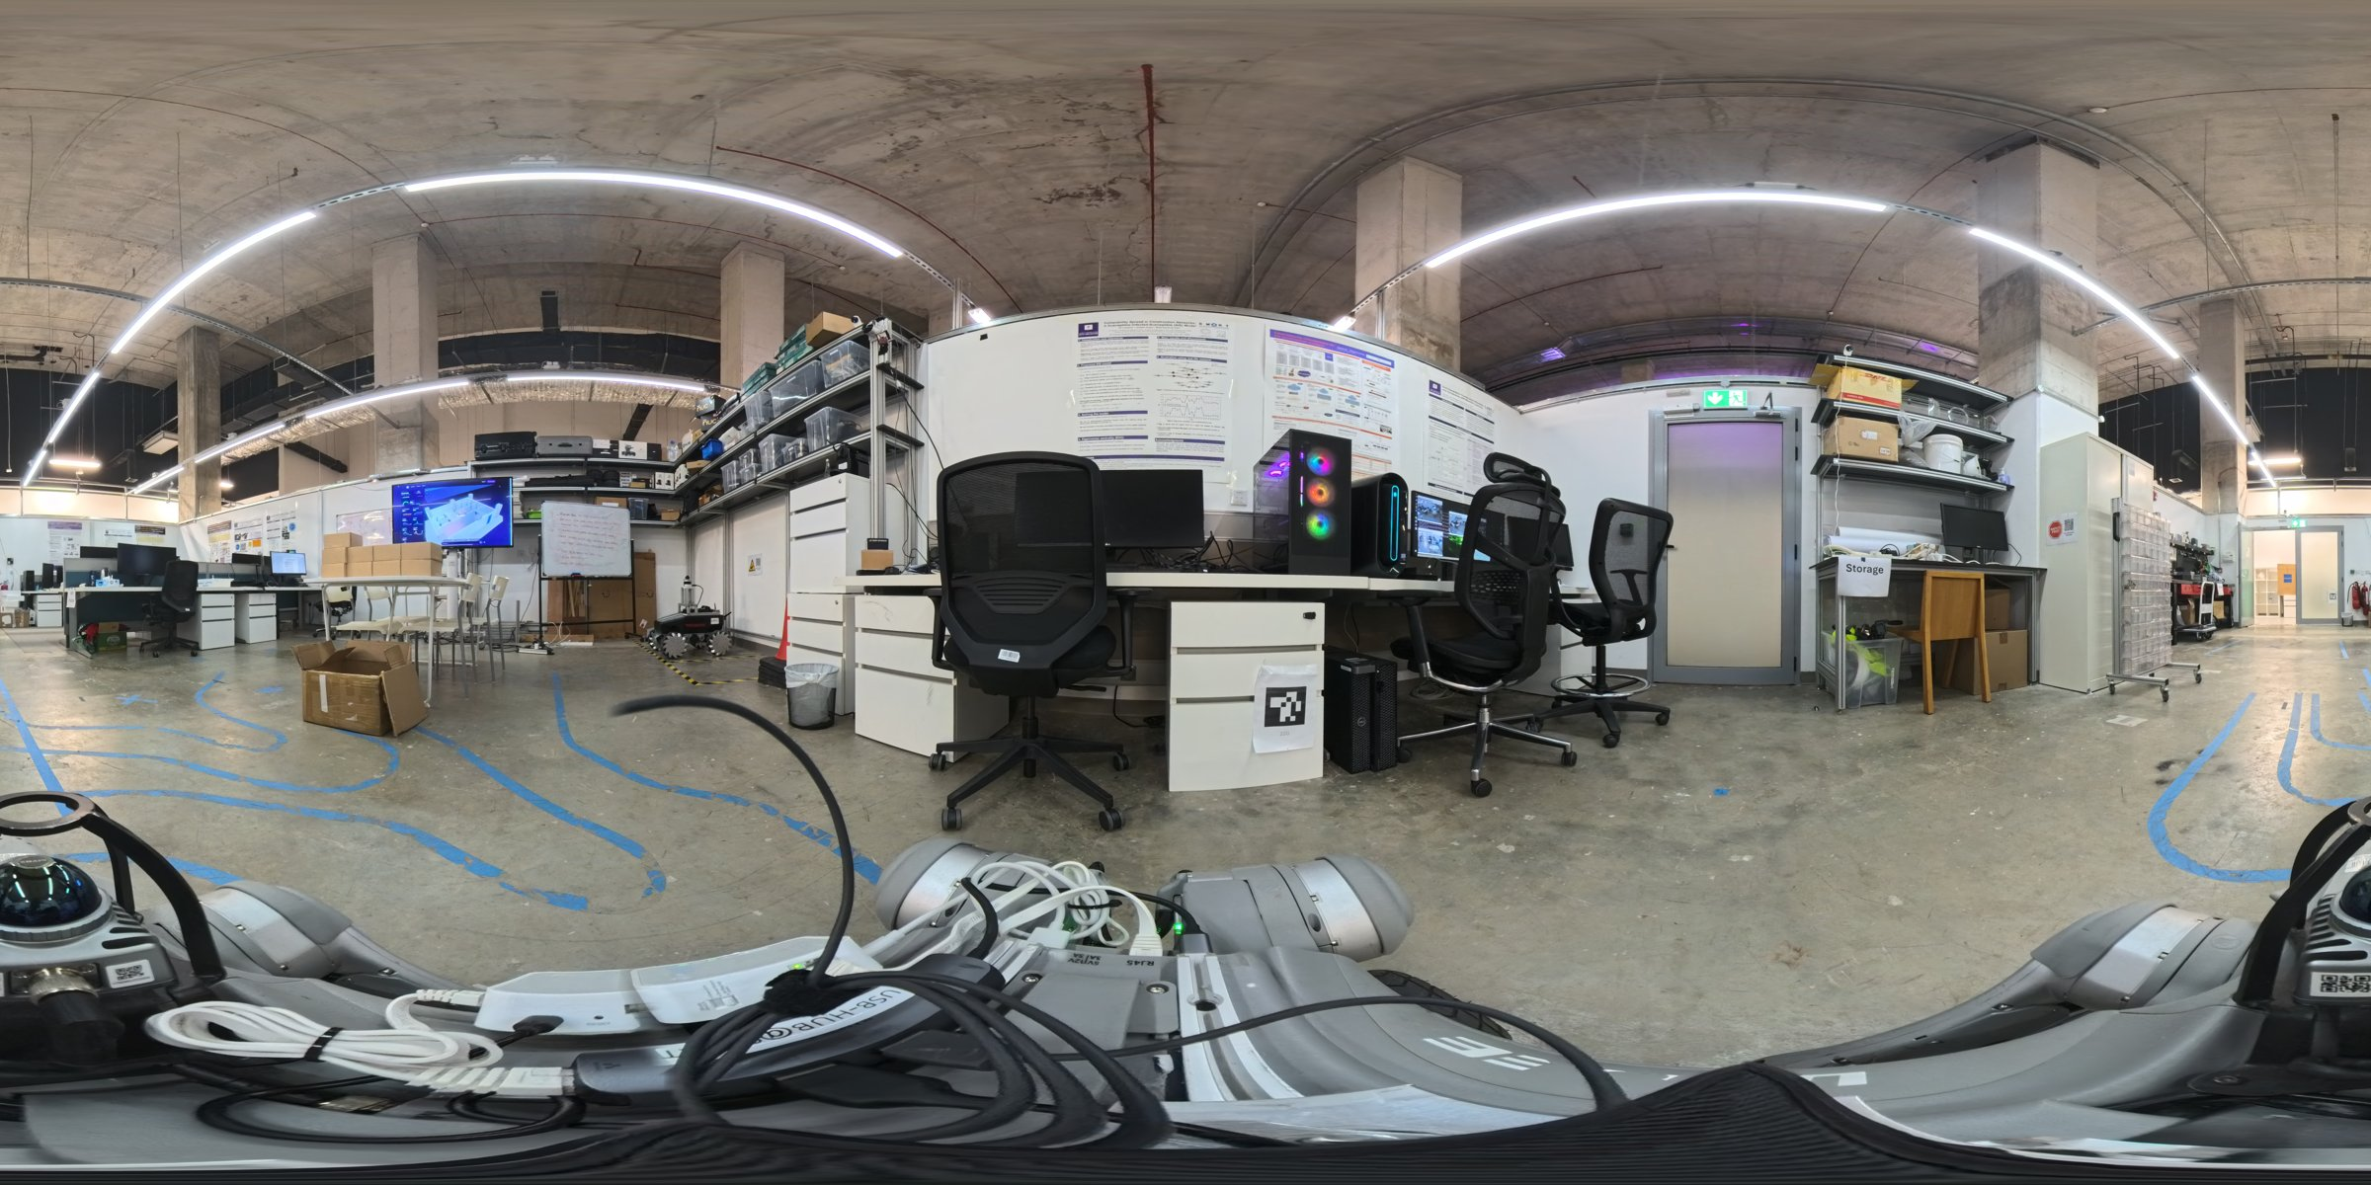
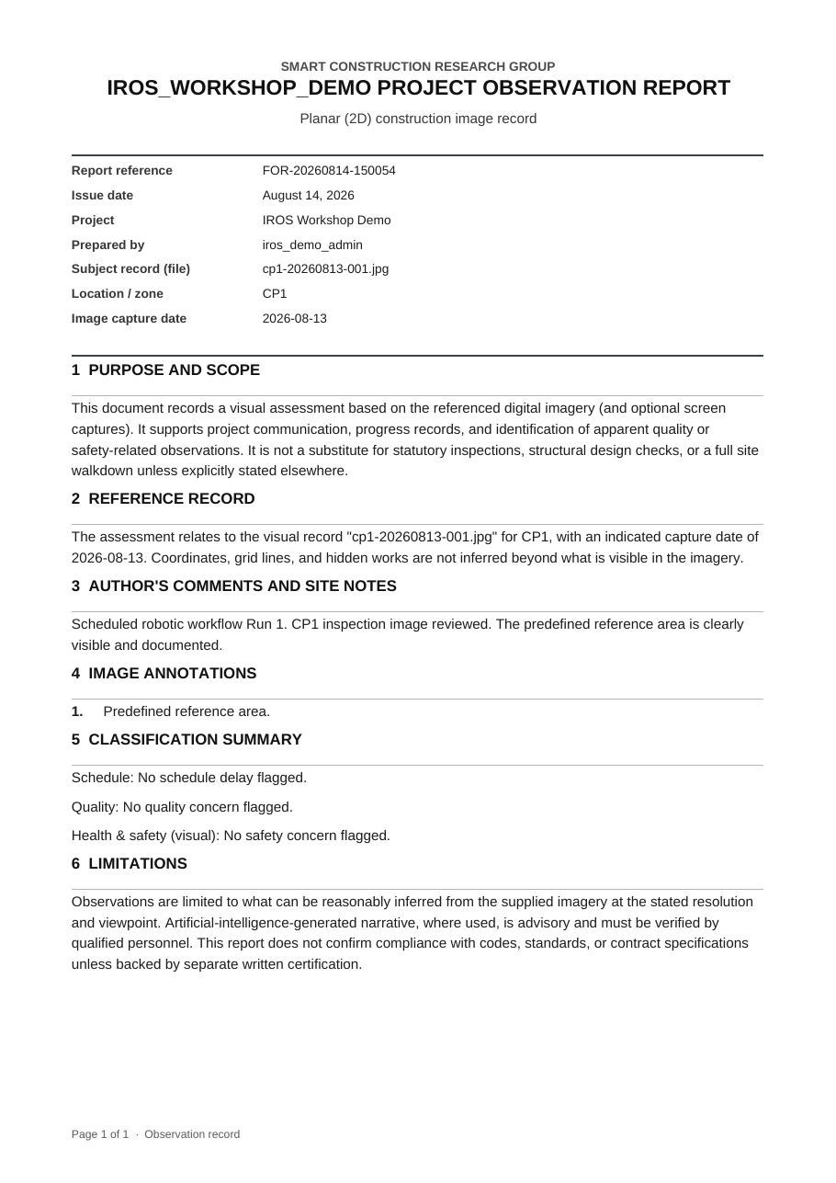
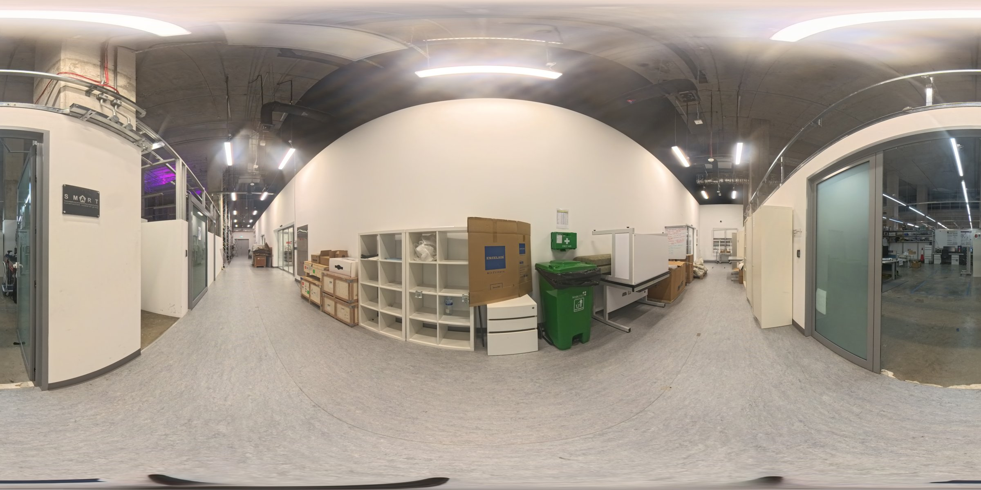
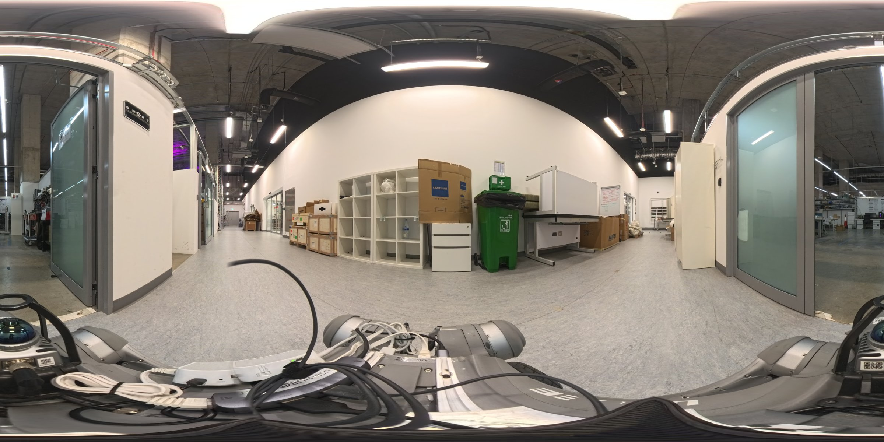
SiteScope | Captured Evidence
05 SITESCOPE
Manual (camera at 1.25 m)
Scheduled robot (camera at 0.67 m)
CP1
CP3
Run 1 panoramas from the experimental package [6]; right: the PDF observation report SiteScope generated from the robot's CP1 image

Slide 13
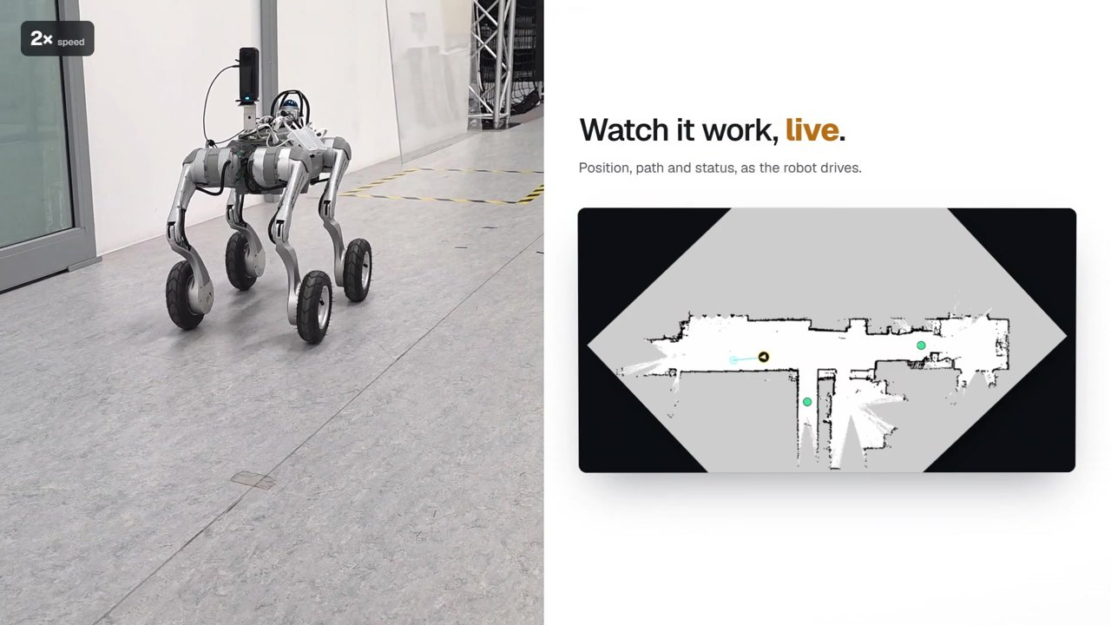
SiteScope | Video
05 SITESCOPE
Full video: a scheduled inspection from robot capture to published report

Slide 14
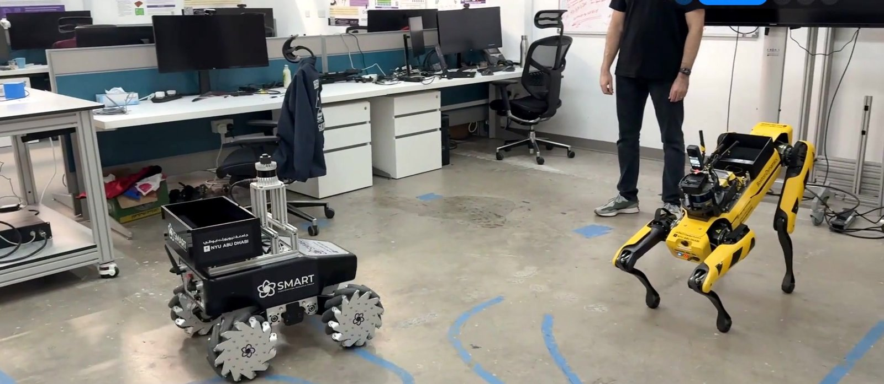
06
Robot Logistics Challenge:
People and Robots as One Team

Slide 15
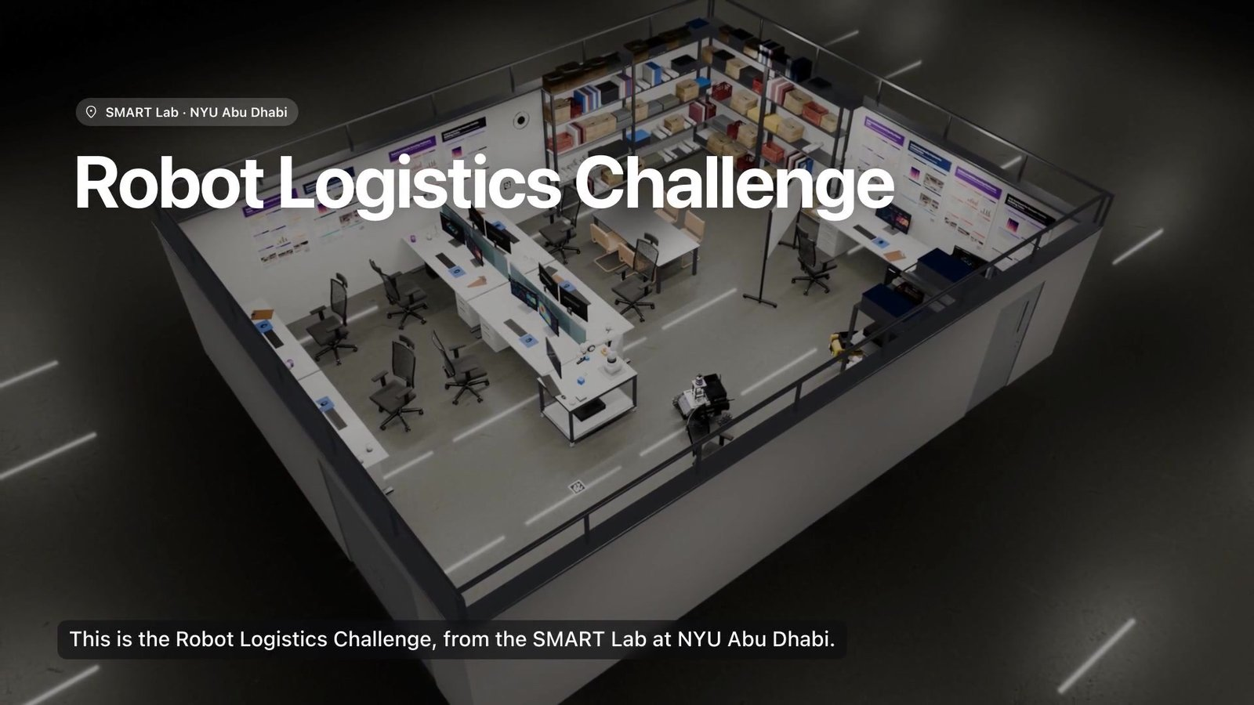
Robot Logistics Challenge | Overview
06 LOGISTICS
5
3
15
people
robots
minutes
People and robots work as one team to complete delivery orders across five stations in the lab.
SUMMIT-XL carries each order between stations.
Spot fetches from storage and reads QR codes.
Franka FR3 arm (REACH Lab) transfers packages.
A lab demonstration, not a publication. Team: B. García de Soto (SUMMIT-XL, Go2-W, integration), S. A. Prieto (Spot, QR materials), F. Abu-Dakka (REACH Lab, FR3 arm), A. Mengiste (lead software developer).

Slide 16
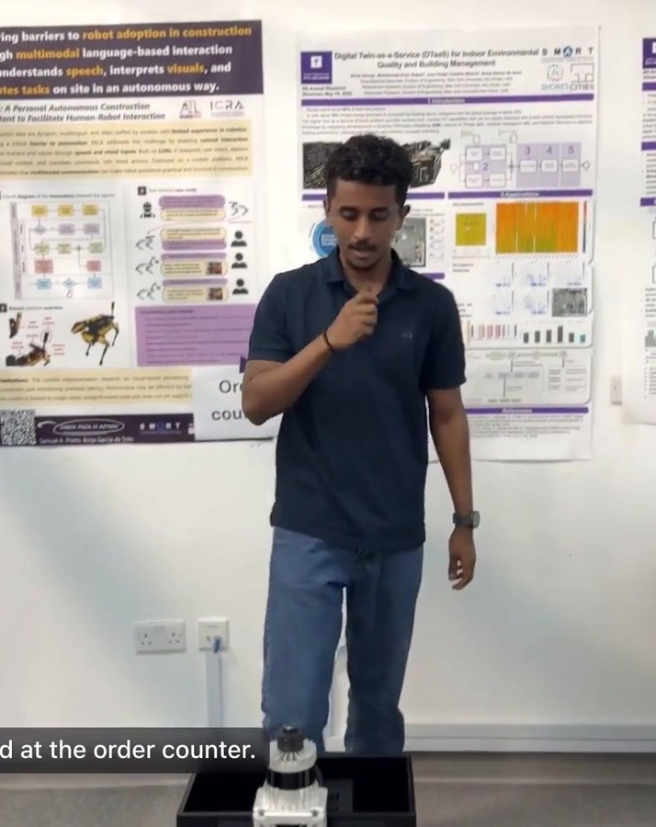
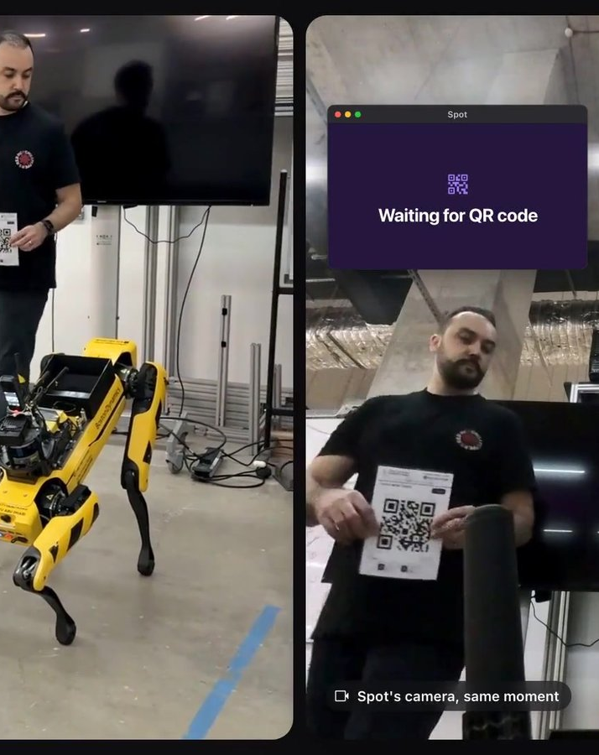
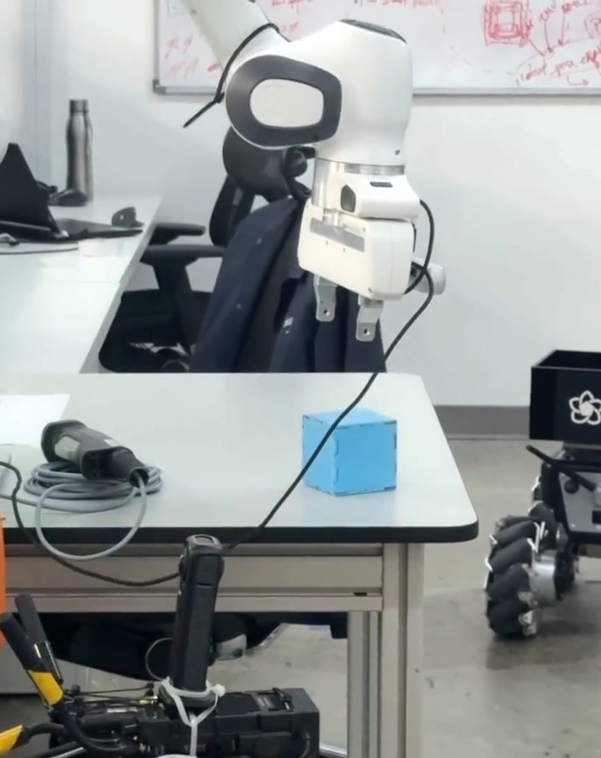
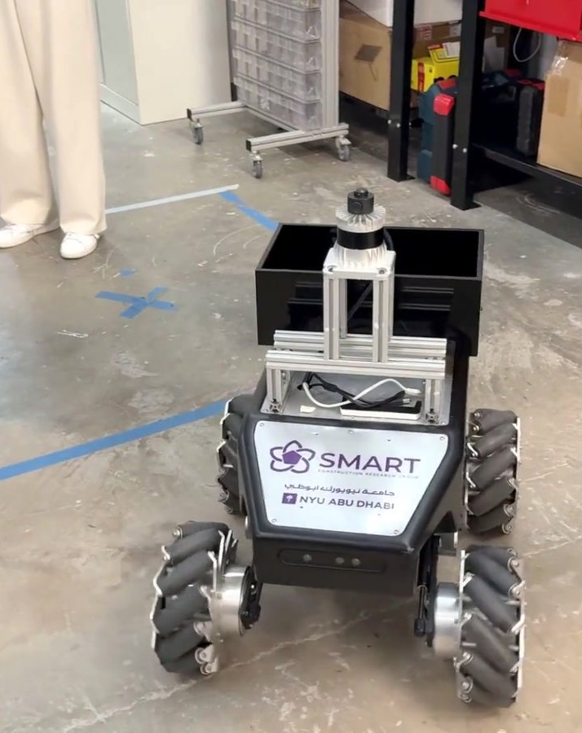
Robot Logistics Challenge | Order Workflow
06 LOGISTICS
1 Order
2 Handoff
3 Storage
4 Arm transfer
5 Delivery
An order starts with a card at the order counter.
SUMMIT-XL drives to the handoff; Spot reads the order's QR code.
At storage, the package is shown to Spot's camera and matched.
The FR3 arm moves the package onto SUMMIT-XL.
SUMMIT-XL delivers the order: complete.
Stills from the Robot Logistics Challenge video, S.M.A.R.T. Lab, NYU Abu Dhabi

Slide 17
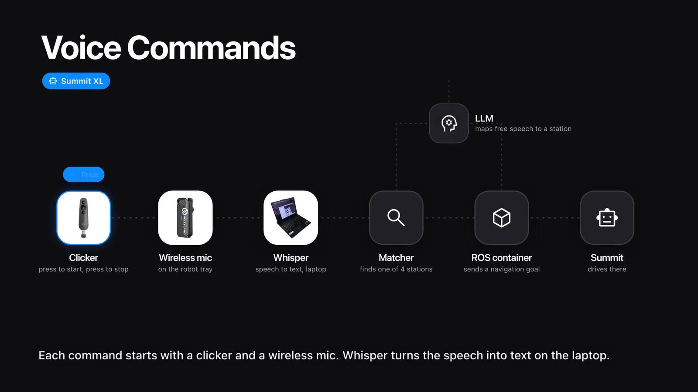
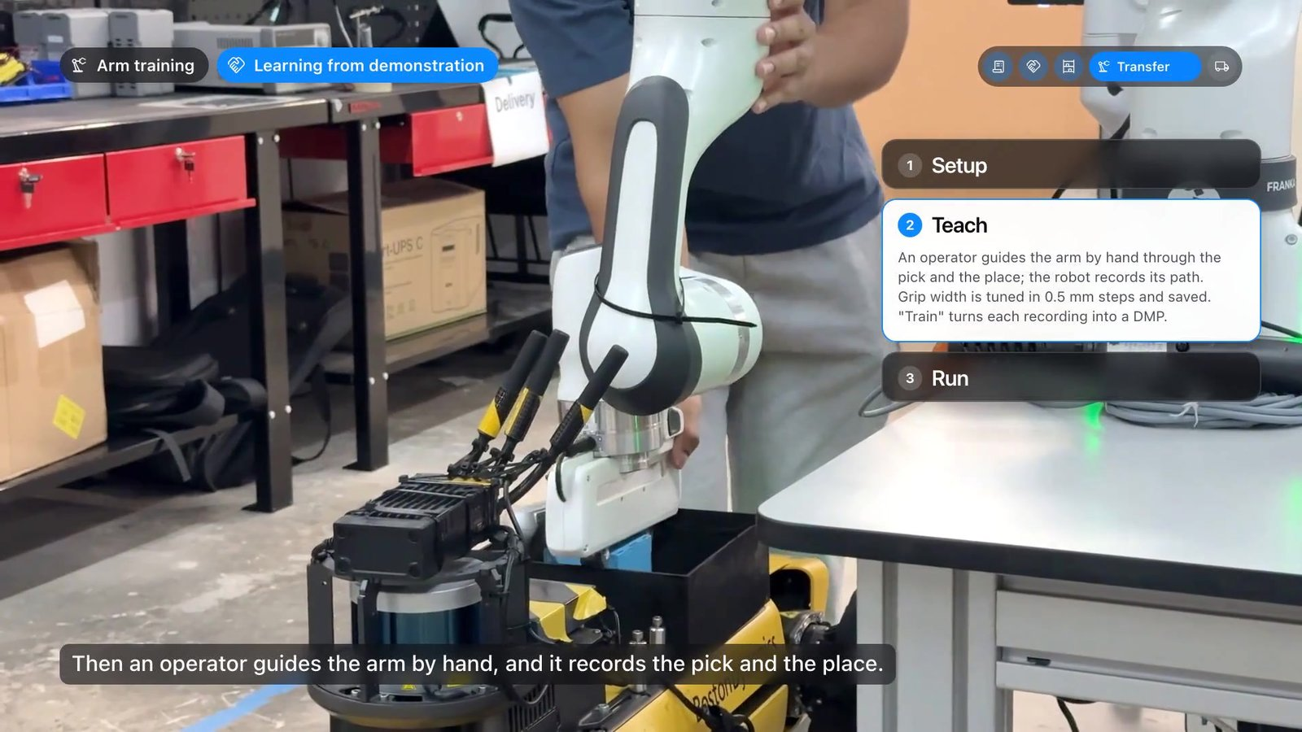
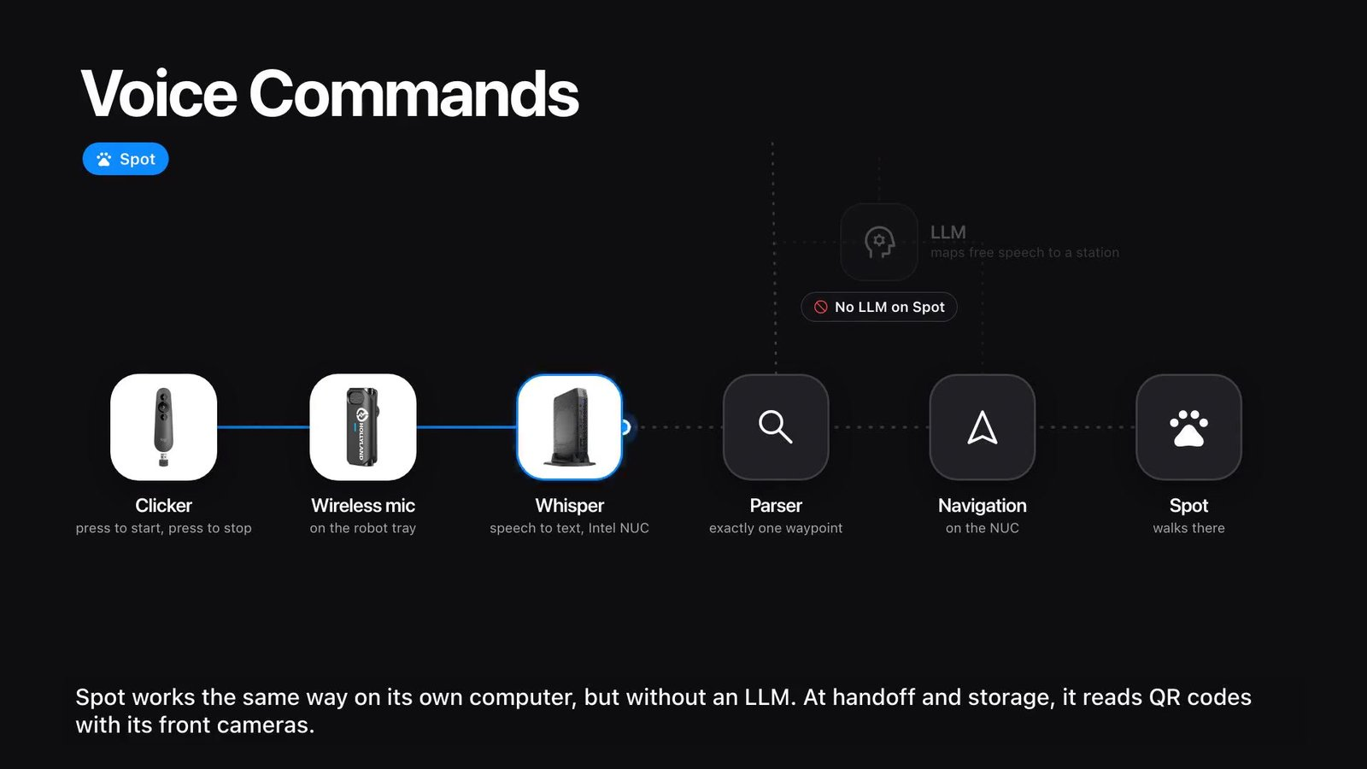
Robot Logistics Challenge | How It Works
06 LOGISTICS
Voice commands: SUMMIT-XL
Clicker + wireless mic → Whisper on a laptop → matcher picks one of the stations; if none matches, an LLM tries; else the command is rejected → ROS container sends the goal.
Arm: learning from demonstration
Setup → Teach (guide the arm by hand) → Run; recordings become motion primitives.
Voice commands: Spot
Same pipeline on its own computer (Intel NUC) but without an LLM: a parser picks exactly one waypoint. At handoff and storage Spot reads QR codes.
Overseer
Cancels any robot's move from a control panel; each robot keeps its own emergency stop.

Slide 18

Robot Logistics Challenge | Video
06 LOGISTICS
Full video: one order from start to finish

Slide 19
References
5
Mengiste, A. T., Prieto, S. A., & García de Soto, B. (2026). SiteScope: An end-to-end schedule-driven robotic workflow for construction progress monitoring. IROS 2026 Workshop (camera-ready).
DOI pending
6
Mengiste, A. T., Prieto, S. A., & García de Soto, B. (2026). IROS Workshop experimental package for SiteScope. New York University Abu Dhabi.
https://github.com/SMART-NYUAD/sitescope-iros-evaluation
4
Gopee, M. A., Prieto, S. A., & García de Soto, B. (2026). Self-hosted multimodal large language models for speech-driven perception and navigation in construction robotics. Automation in Construction, 183, 106805.
https://doi.org/10.1016/j.autcon.2026.106805

Slide 20




THANK YOU
Borja García de Soto, PhD, PE
Associate Professor
garcia.de.soto@nyu.edu

